Slide 1
Lesson 6-8 SQL
A3.3 Database Programming

Slide 2
L6 - Syllabus Links
A3.3.2 Construct queries between two tables in SQL.
Queries must include joins, relational operators, filtering, pattern matching, and ordering data
SQL commands: SELECT, DISTINCT, FROM, WHERE, BETWEEN, ORDER BY, GROUP BY, HAVING, ASC, DESC, JOIN, LIKE with % wildcard, AND, OR, NOT (note: Syntax may vary in different database systems)

Slide 3
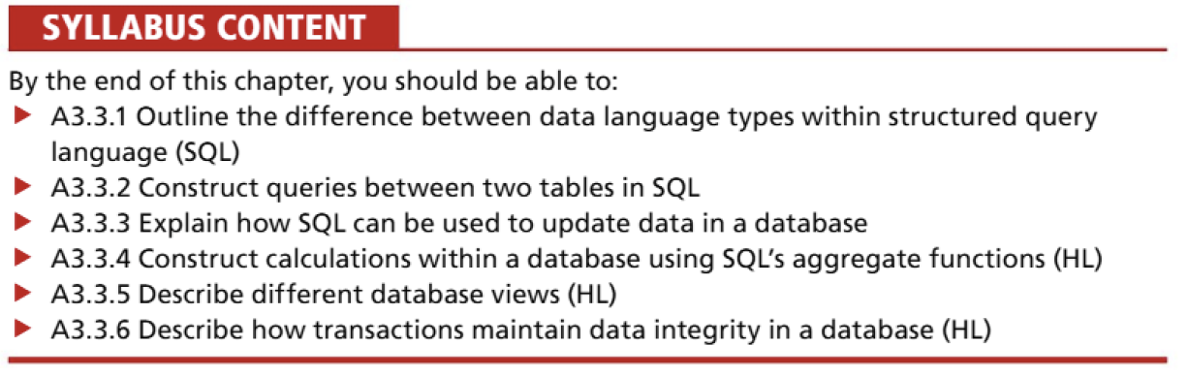
Lesson 6
SQL
By the end of this lesson you will be able to
Outline the differences between DDL and DML in SQL
Identify key SQL DDL statements and their purpose
Construct SQL DDL statements to define and modify database structures

Slide 4
Recap of prior learning - Normal Forms

Slide 5
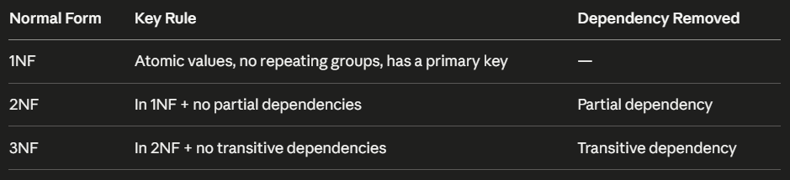
Normal Forms

Slide 6
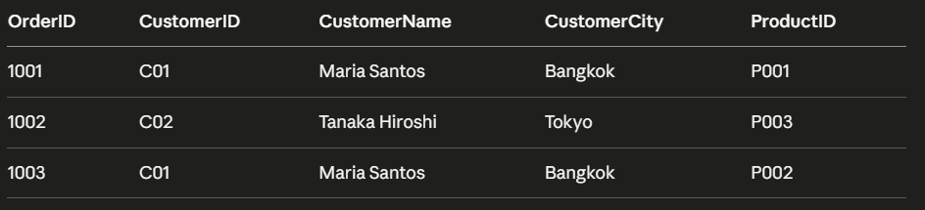
Recap: Spot the Problem (THINK PAIR SHARE)
What is wrong with this table?
Worksheet task 2
Which normal form does this satisfy?
What is the dependency problem?
How would you fix it?

Slide 7
RECAP ANSWER
The Problem: Transitive Dependency
CustomerName and CustomerCity depend on CustomerID, not on OrderID (the primary key)
This is a transitive dependency — violates 3NF
Fix is to split into two tables:
ORDER (OrderID, CustomerID, ProductID)
CUSTOMER (CustomerID, CustomerName, CustomerCity)

Slide 8
What is SQL?
SQL ( Structured Query Language )
The standard language for communicating with relational databases
Divided into two sub-languages with distinct purposes:
 | DDL | DML
Stands for | Data Definition Language | Data Manipulation Language
Acts on | The structure of the database | The data inside the database
Key idea | Build and modify the schema | Read and write records

Slide 9
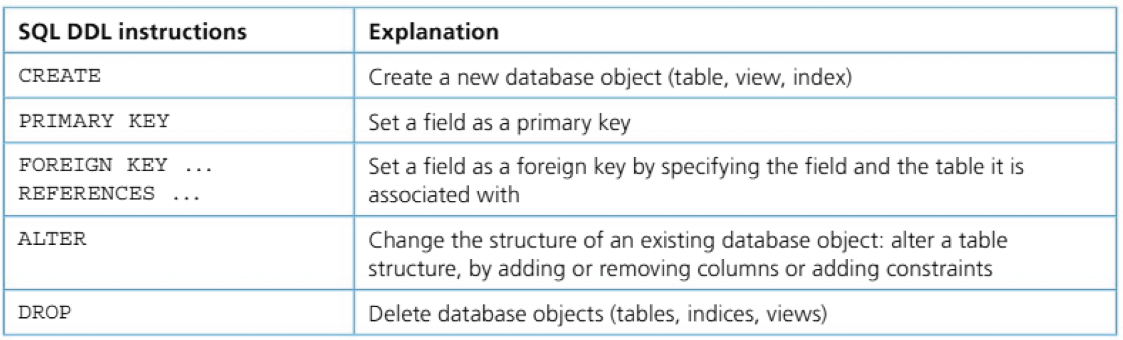
Data definition language (DDL)
Data definition language (DDL) is used to create, modify and remove data structures from a relational database.

Slide 10
Worked Example
Eastfield Police Station (New Database)
The station needs a database to manage officers and incidents.
Two tables:
OFFICER — stores details about each officer
INCIDENT — stores details about reported incidents
You have the full schema on your worksheet. 1 minute to read it before I start typing.

Slide 11
CREATE DATABASE
CREATE DATABASE POLICE

Slide 12
CREATE TABLE OFFICER
CREATE TABLE OFFICER (
OfficerID CHARACTER(6) PRIMARY KEY,
FirstName VARCHAR(50),
LastName VARCHAR(50),
Rank VARCHAR(30),
BadgeNumber INTEGER,
StationCode CHARACTER(4)
);
Why is OfficerID defined as CHARACTER(6) rather than INTEGER or VARCHAR?
fixed-length identifiers like PC0042 are always the same length, so CHARACTER is more efficient than VARCHAR and more appropriate than INTEGER as it contains letters.

Slide 13
CREATE TABLE STATION
CREATE TABLE STATION(
StationCode INT PRIMARY KEY,
StationName VARCHAR(100) NOT NULL,
City VARCHAR(100)
);

Slide 14
CREATE INCIDENT TABLE
CREATE TABLE INCIDENT (
IncidentID INTEGER PRIMARY KEY,
IncidentType VARCHAR(100),
IncidentDate DATE,
Location VARCHAR(150),
OfficerID CHARACTER(6),
Status VARCHAR(20),
FOREIGN KEY (OfficerID) REFERENCES OFFICER(OfficerID)
);

Slide 15
Predict
What would happen if you tried to INSERT an incident record with an OfficerID that does not exist in the OFFICER table?
Referential integrity Issue. The DBMS will reject the insert because the foreign key constraint is violated. The child record cannot reference a parent that does not exist.

Slide 16
ALTER TABLE
ALTER TABLE OFFICER
ADD Email VARCHAR(100);
Your turn: write the ALTER statement to add:
YearsService INTEGER to the OFFICER table
-- ALTER TABLE: Drop a column
ALTER TABLE officer
DROP COLUMN email;

Slide 17
CREATE INDEX
CREATE INDEX idx_case_type
ON INCIDENT(IncidentType);

Slide 18
CRATE VIEW
Creating a view INCIDENT_OFFICER_VIEW
Rather than repeatedly joining INCIDENT and OFFICER in queries, we can create a view that presents the combined data as a virtual table.
CREATE VIEW INCIDENT_OFFICER_VIEW AS
SELECT INCIDENT.IncidentID,
INCIDENT.IncidentType,
INCIDENT.IncidentDate,
INCIDENT.Location,
INCIDENT.Status,
OFFICER.OfficerID,
OFFICER.FirstName,
OFFICER.LastName,
OFFICER.Rank
FROM INCIDENT
JOIN OFFICER ON INCIDENT.OfficerID = OFFICER.OfficerID;

Slide 19
2 Types of VIEW (HL)
 | Regular View | Materialised View
Stores | The query definition only | The query result (pre-computed data)
Data freshness | Always live - reflects the current state of the underlying tables | Snapshot - must be refreshed to reflect changes
Speed | Slower - reruns the query every time it is accessed | Faster - reads stored results directly
Storage | No extra storage needed | Requires additional storage space
SQL keyword | CREATE VIEW | CREATE MATERIALIZED VIEW

Slide 20
Predict
Is INCIDENT_OFFICER_VIEW a real table stored in the database? How do you know?
If an officer's rank is updated in the OFFICER table, what happens to the data you see when you query the view?
A view is a virtual table, it stores the query definition, not the data itself. Because it pulls live from the underlying tables, any update to OFFICER is immediately reflected when the view is queried. This is a good hook into the difference between a regular view and a materialised view, which you will see at HL.

Slide 21
Today’s Task
Your Turn: DDL Tasks (Worksheet Section 3)
Task 3 - Classify each SQL statement as DDL or DML
Task 4 - Annotate a CREATE TABLE statement line by line
Task 5 - Design and write a VEHICLE table from scratch, then peer-check

Slide 22
DML
Data Manipulation Language (DML) is the subset of SQL used to read and modify data in a database.
SELECT, FROM, WHERE

Slide 23
Choosing Columns & Tables
SELECT specifies which columns to retrieve. FROM tells SQL which table to look in.
Command | Purpose
SELECT | Read / retrieve data
INSERT | Add new rows
UPDATE | Modify existing rows
DELETE | Remove rows

Slide 24
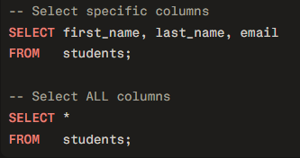
student_id | first_name | last_name | email | grade
1 | Anya | Kovach | anya@sisbschool.com | A
2 | Boon | Sriwong | boon@sisbschool.com | B
3 | Chloe | Park | chloe@sisbschool.com | A
4 | Dev | Patel | dev@sisbschool.com | C
⚡ Tip: Avoid SELECT * in production, only name the columns you need.

Slide 25
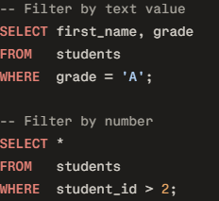
WHERE Clause
student_id | first_name | grade
✅ 1 | Anya | A
❌ 2 | Boon | B
✅ 3 | Chloe | A
❌ 4 | Dev | C

Slide 26
WHERE Clause
Operator | Meaning
= | Equals
<> | Not equals
> / < | Greater / Less than
>= / <= | Greater or equal / Less or equal
LIKE | Pattern match (e.g. 'A%')
student_id | first_name | grade
❌ 1 | Anya | A
❌ 2 | Boon | B
✅ 3 | Chloe | A
✅4 | Dev | C
student_id | first_name | grade
✅ 1 | Anya | A
❌ 2 | Boon | B
✅ 3 | Chloe | A
❌ 4 | Dev | C

Slide 27
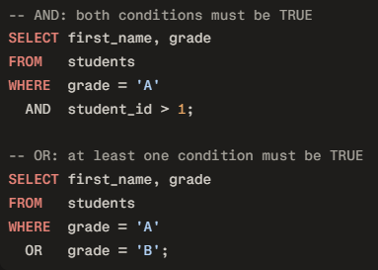
AND / OR + Full Syntax
SELECT column1, column2
FROM table_name
WHERE condition;
 | AND | OR
Condition required | Both must be true | Either can be true
Rows returned | Fewer (narrower) | More (broader)
Example result | Chloe only (1 row) | Anya, Boon, Chloe (3 rows)

Slide 28
Worked Example
employee_id | first_name | last_name | department | salary | hire_date
1 | Sara | Malone | Marketing | 45000 | 2021-03-15
2 | James | Tran | IT | 72000 | 2019-07-01
3 | Priya | Nair | HR | 38000 | 2022-11-20
4 | Kevin | Wong | IT | 68000 | 2020-05-10
5 | Laura | Smith | Marketing | 51000 | 2018-01-30
6 | Ahmed | Hassan | HR | 41000 | 2023-02-14

Slide 29
Worked Example
employee_id | first_name | last_name | department | salary | hire_date
1 | Sara | Malone | Marketing | 45000 | 2021-03-15
2 | James | Tran | IT | 72000 | 2019-07-01
3 | Priya | Nair | HR | 38000 | 2022-11-20
4 | Kevin | Wong | IT | 68000 | 2020-05-10
5 | Laura | Smith | Marketing | 51000 | 2018-01-30
6 | Ahmed | Hassan | HR | 41000 | 2023-02-14
Task: Retrieve only the first name, last name, and department of all employees.
SELECT first_name, last_name, department
FROM employees;
first_name | last_name | department
Sara | Malone | Marketing
James | Tran | IT
Priya | Nair | HR
Kevin | Wong | IT
Laura | Smith | Marketing
Ahmed | Hassan | HR

Slide 30
Task 2
employee_id | first_name | last_name | department | salary | hire_date
1 | Sara | Malone | Marketing | 45000 | 2021-03-15
2 | James | Tran | IT | 72000 | 2019-07-01
3 | Priya | Nair | HR | 38000 | 2022-11-20
4 | Kevin | Wong | IT | 68000 | 2020-05-10
5 | Laura | Smith | Marketing | 51000 | 2018-01-30
6 | Ahmed | Hassan | HR | 41000 | 2023-02-14
Find all employees who work in the IT department.
SELECT first_name, last_name, salary
FROM employees
WHERE department = 'IT';
SQL + Table Results?
first_name | last_name | salary
James | Tran | 72000
Kevin | Wong | 68000

Slide 31
Task 3
employee_id | first_name | last_name | department | salary | hire_date
1 | Sara | Malone | Marketing | 45000 | 2021-03-15
2 | James | Tran | IT | 72000 | 2019-07-01
3 | Priya | Nair | HR | 38000 | 2022-11-20
4 | Kevin | Wong | IT | 68000 | 2020-05-10
5 | Laura | Smith | Marketing | 51000 | 2018-01-30
6 | Ahmed | Hassan | HR | 41000 | 2023-02-14
Task: Find employees in Marketing who earn more than 48,000.
SELECT first_name, last_name, department, salary
FROM employees
WHERE department = 'Marketing'
AND salary > 48000;
SQL + Table Results?
first_name | last_name | department | salary
Laura | Smith | Marketing | 51000

Slide 32
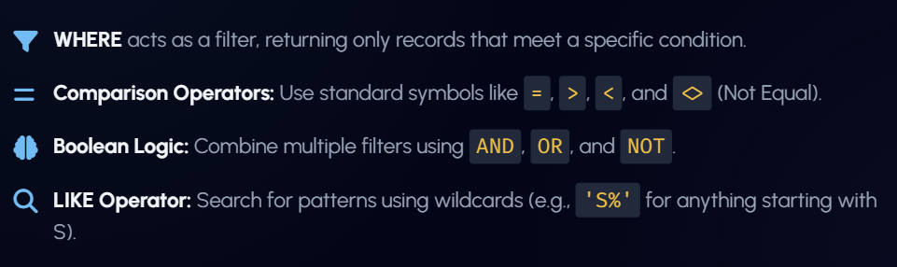
Remember…

Slide 33
Try Yourself
CREATE TABLE employees (
employee_id INT PRIMARY KEY,
first_name VARCHAR(50) NOT NULL,
last_name VARCHAR(50) NOT NULL,
department VARCHAR(50),
salary DECIMAL(10,2),
hire_date DATE
);

Slide 34
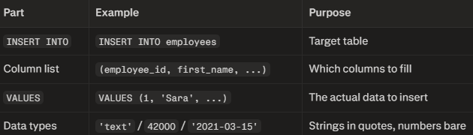
INSERT Logic
-- Insert all employees one by one
INSERT INTO employees (employee_id, first_name, last_name, department, salary, hire_date)
VALUES (1, 'Sara', 'Malone', 'Marketing', 45000, '2021-03-15');
INSERT INTO employees (employee_id, first_name, last_name, department, salary, hire_date)
VALUES (2, 'James', 'Tran', 'IT', 72000, '2019-07-01');
INSERT INTO employees (employee_id, first_name, last_name, department, salary, hire_date)
VALUES (3, 'Priya', 'Nair', 'HR', 38000, '2022-11-20');
INSERT INTO employees (employee_id, first_name, last_name, department, salary, hire_date)
VALUES (4, 'Kevin', 'Wong', 'IT', 68000, '2020-05-10');
INSERT INTO employees (employee_id, first_name, last_name, department, salary, hire_date)
VALUES (5, 'Laura', 'Smith', 'Marketing', 51000, '2018-01-30');
INSERT INTO employees (employee_id, first_name, last_name, department, salary, hire_date)
VALUES (6, 'Ahmed', 'Hassan', 'HR', 41000, '2023-02-14');

Slide 35
INSERT Logic - more efficient
-- Insert all 6 rows in a single statement
INSERT INTO employees (employee_id, first_name, last_name, department, salary, hire_date)
VALUES
(1, 'Sara', 'Malone', 'Marketing', 45000, '2021-03-15'),
(2, 'James', 'Tran', 'IT', 72000, '2019-07-01'),
(3, 'Priya', 'Nair', 'HR', 38000, '2022-11-20'),
(4, 'Kevin', 'Wong', 'IT', 68000, '2020-05-10'),
(5, 'Laura', 'Smith', 'Marketing', 51000, '2018-01-30'),
(6, 'Ahmed', 'Hassan', 'HR', 41000, '2023-02-14');

Slide 36
Exam Questions (Section 4)
Exam Practice: Worksheet Section 4
Q1: State what is meant by DDL. [2]
Q2: Outline the difference between DDL and DML in SQL. [4]
Q3: Police force scenario: identify sub-language, write ALTER, explain data types. [7]

Slide 37
Plenary:
⭐ Exit Ticket:
On a scale of 1-5, how confident are you?
1 □ 2 □ 3 □ 4 □ 5 □
Before you go, answer these on your worksheet:
What is the difference between DDL and DML?
Write one DDL statement from today's lesson and explain what it did.
Why would you use ALTER rather than DROP and re-create a table?

Slide 38
SQL JOIN

Slide 39
L7 - Syllabus Links
SQL joins
A3.3.2 Construct queries between two tables in SQL.
Queries must include joins, relational operators, filtering, pattern matching, and ordering data
SQL commands: SELECT, DISTINCT, FROM, WHERE, BETWEEN, ORDER BY, GROUP BY, HAVING, ASC, DESC, JOIN, LIKE with % wildcard, AND, OR, NOT (note: Syntax may vary in different database systems)

Slide 40
In this lesson, we build on that knowledge with commands that make queries more powerful and more precise:
DISTINCT (remove duplicates)
BETWEEN, ORDER BY,
GROUP BY, HAVING, (summarise)
ASC, DESC, (sort)
JOIN, (link tables)

Slide 41
Simple SELECT Query
SELECT first_name, last_name, department
FROM employees
WHERE department = 'IT';

Slide 42
DISTINCT, BETWEEN, ORDER BY
DISTINCT removes duplicate values from the results, so each value appears only once.
BETWEEN selects values inside a range, usually numbers, dates, or alphabetical values.
ORDER BY sorts the results.
ASC means ascending order, for example A to Z or smallest to largest.
DESC means descending order, for example Z to A or largest to smallest.
SELECT DISTINCT department
FROM employees;
SELECT first_name, last_name, salary
FROM employees
WHERE salary BETWEEN 40000 AND 70000;
SELECT first_name, last_name, salary
FROM employees
ORDER BY salary DESC;

Slide 43
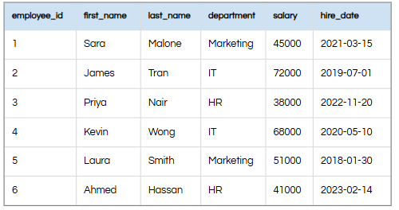
GROUP BY and HAVING
GROUP BY puts rows with the same value together into groups.
It is often used with aggregate functions such as COUNT(), SUM(), AVG(), MIN(), and MAX().
HAVING filters groups after they have been created.
WHERE filters individual rows before grouping, but HAVING filters grouped results after grouping.
SELECT department, COUNT(*) AS total_staff
FROM employees
GROUP BY department;
SELECT department, COUNT(*) AS total_staff
FROM employees
GROUP BY department
HAVING total_staff > 1;
WHERE salary > 40000 → filters rows.
HAVING COUNT(*) > 2 → filters groups.

Slide 44
GROUP BY and HAVING
JOIN combines data from two tables into one result.
It works by matching a related field in both tables, usually a primary key and a foreign key.
This allows us to display useful information from different tables in a single query.
In the current lesson deck, a correct example joins students and classes using the shared class_id, while incorrect joins either miss the ON condition or match unrelated columns.
Explanation:
students is given the alias s.
classes is given the alias c.
JOIN links the two tables.
ON tells SQL how the rows are matched.
SELECT s.name, c.class_name
FROM students s
JOIN classes c
ON s.class_id = c.class_id;
A join should connect related columns, not just columns with similar names.

Slide 45
Worked Examples
Show all unique department names using DISTINCT.
Show employees with salaries between 40000 and 60000 using BETWEEN.
Show all employees sorted by hire date from newest to oldest using ORDER BY DESC.
Count how many employees are in each department using GROUP BY.
Show only departments with more than one employee using HAVING.
Show students and their class names by joining the students and classes tables.

Slide 46
SQL INSERT & UPDATE

Slide 47
L8 - Syllabus Links
SQL update & insert
A3.3.3 Explain how SQL can be used to update data in a database.
Insert new records (INSERT INTO), modify data (UPDATE SET), remove data (DELETE)
The performance implications of updating data in indexed columns, and how indexes might need to be rebuilt or reorganized following significant data modifications

Slide 48
Lesson 8
SQL UPDATE & INSERT
By the end of this lesson you will be able to
Use INSERT, UPDATE and DELETE to change data in a table.
Explain how these SQL commands add, modify or remove records in a database.
Outline how updates on indexed columns can affect performance and why indexes may need rebuilding after large data changes.

Slide 49
Recap: Odd One Out
Identify the odd one out (correct syntax) - two of the statements are incorrect
# | SQL statement | Correct? | Reason/Identify
1 | SELECT s.name, c.class_name FROM students s JOIN classes c;
2 | SELECT s.name, c.class_name FROM students s JOIN classes c ON s.student_id = c.class_id;
3 | SELECT s.name, c.class_name FROM students s JOIN classes c ON s.class_id = c.class_id;

Slide 50
Odd One Out
Identify the odd one out (incorrect syntax)
# | SQL statement | Correct? | Comment
1 | SELECT s.name, c.class_name FROM students s JOIN classes c; | No | Missing ON condition, so it returns a Cartesian product of both tables.jooq+1
2 | SELECT s.name, c.class_name FROM students s JOIN classes c ON s.student_id = c.class_id; | No | Joins on unrelated columns (student_id vs class_id), so the relationship is wrong.stackoverflow+1
3 | SELECT s.name, c.class_name FROM students s JOIN classes c ON s.class_id = c.class_id; | Yes | Correct inner join using the shared key class_id between the two tables.w3resource+1

Slide 51


INSERT
https://www.w3schools.com/sql/sql_insert.asp
The INSERT INTO statement is used to insert new records in a table.
It is possible to write the INSERT INTO statement in two ways:

Slide 52
Practical Task - INSERT INTO
INSERT new information into your Police database
Tables:
Station
INSERT INTO STATION VALUES ('EF03','Westfield Central','Westfield North','01248675765','Chief Supt. Smith');
Vehicle
Model = Ford Explorer, Type = 4x4
Officer
Add a new police officer MingMing! Badge 9999 and ID PC0001
Incident
Add a new incident of burglary by PC0078 that is “Under Review” that took place on 14/5/26

Slide 53
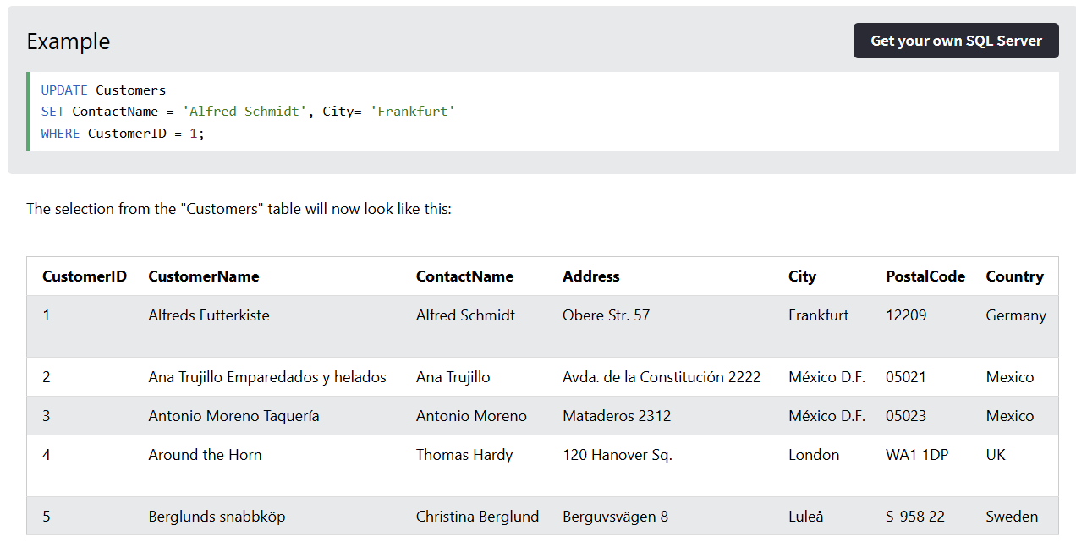
UPDATE
The UPDATE statement is used to update or modify one or more records in a table.
https://www.w3schools.com/sql/sql_update.asp

Slide 54
Practical Task - UPDATE
Complete the tasks in your booklet and paste your commands + the results of the table updates using SELECT statements
Cheatsheet can be found on the classroom for you to use

Slide 55
Plenary - Exam Questions
Question 1 – SQL join
A school database has the following tables.
Student(StudentID, Name, ClassID) Class(ClassID, ClassName, Room)
a) Write an SQL query to display each student's name together with the name of the class they are in. Use table aliases. b) Explain the purpose of the join in your query in part (a).
Command term focus: write, explain; concepts: relational model, foreign key, inner join.

Slide 56
Question 2 – SQL insert / update
A table Book(BookID, Title, Author, InStock) stores information about books in a library.
a) Write an SQL statement to insert a new book with BookID 501, title 'AI in Education', author 'Nguyen', and InStock value 3. b) A mistake was made and the library actually has 5 copies in stock. Write an SQL statement to correct the InStock value for this book only. c) State one possible consequence of forgetting to include an appropriate WHERE clause in your UPDATE statement.

Slide 57
ANSWERS
SELECT s.Name, c.ClassName
FROM Student AS s
JOIN Class AS c
ON s.ClassID = c.ClassID;
b)
The join combines rows from the Student and Class tables into a single result set.
It matches each student to the class with the same ClassID (primary/foreign key relationship).
This allows the query to show data from both tables in one output (for example, student name with class name).

Slide 58
ANSWERS - Q2
INSERT INTO Book (BookID, Title, Author, InStock)
VALUES (501, 'AI in Education', 'Nguyen', 3);
UPDATE Book
SET InStock = 5
WHERE BookID = 501;
One consequence is that all rows in the table could be updated, leading to incorrect stock levels for every book and potential loss of accurate data.

